Slide 1
Ascente
Start the recording …………………………….
Flat Rate Processing
Can everyone see this screen?
Please full-size the presentation on your screen.
Please let me know if you can’t hear me?
You need to call into the conference phone # to hear me.

Slide 2
Ascente
FLAT RATE Processing
Presenter: Mark Allman
May 2017
www.compusource.com
http://www.servicecontractorsoftware.com/

Slide 3
Ascente – Flat Rate Processing
Overview
Flat Rate Processing refers to pricing using a quoted amount as opposed to a time and material basis.
Typically a Flat Rate Book is created that will list all of the predetermined Flat Rate Tasks and prices for those tasks along with the labor and parts required.
Your sale price is predetermined and calculated based on your calculations of all of the costs required for the Flat Rate Task.
The use of these Flat Rate Tasks / Bill of Materials will make data entry much quicker.

Slide 4
Ascente – Flat Rate Processing
Objectives
We are going to provide a brief overview of the benefits of Flat Rate Module:
Benefits
Create and Maintain your own Flat Rate / Part Bill of Materials
Flat Rate Database Import & Update
Flat Rate Price Books
Flat Rate Task Analysis Report
Pricing
Predetermined Pricing
Multiple Pricing Levels
Ease of Data Entry

Slide 5
Ascente – Flat Rate Processing
Flat Rate Database Import & Update
The Ascente – Flat Rate module will allow you to either:
Import Kimmons1 & Kimmons2 flat rate database files created by either:
A vendors selling these databases such as Callahan Roach.
Created by any of multiple software programs that can export to the standard Kimmons1 & Kimmons2 file format.
These kimmons* files can be used to create new records or just update existing Part and Part Bill of Material Records.

Slide 6
Ascente – Flat Rate Processing
What is a Part Bill or Materials / Flat Rate Task?
The terms Part Bills of Material and Flat Rate Task refer to the same thing and can be used interchangeably. I often refer to these as tasks.
This is a part (Parent Part) that when entered, will then result in a predetermined set of parts (Component Parts) being automatically entered.
Part Bills of Material are required in order to print the Ascente – Flat Rate Price Books or use the Flat Rate Task Analysis Report.

Slide 7
Ascente – Flat Rate Processing
Component Part Records
Labor
$100
Part Bill of Material /
Flat Rate Task /
Parent Part
(All Part Records)
AC-100
$2000
ACG-020
$2,325
R11 Freon
$150
Component Part Level Pricing
PartBOM /
Task Level Pricing
CX233 Valve
$25
TSTAT
$50

Slide 8
Ascente – Flat Rate Processing
Creating a Part Bill of Material Record
The first step is to determine what typical service you provide you want to create a task for. (Parent Part)
The next step is to determine how much labor if should take to complete this task. (Component Part)
Determine the materials and any other costs that are required to complete this task. (Component Parts)
Now based on the costs for this task, you need to determine the final price you want to charge for this task and then enter the price(s) into the Parent Part record.

Slide 9
Ascente – Flat Rate Processing
Creating a Part Bill of Material Record
Create the Parent Part with Prices
Make the Product Line be a Task Product Line
Inventory / Maintenance / Part program
Verify that the Component Parts Exist. If they do not, create them.
The Product Line should not be a Task Product Line.
Enter the correct cost and sell prices
Inventory / Maintenance / Part program

Slide 10
Ascente – Flat Rate Processing
Creating a Part Bill of Material Record
Worksheet / Example: Install Toilet
You will need to determine the following in order to determine what your sell price is for this task will be.
The totals below are calculated based on a time and material basis. You can set the task price to be what ever you want it to be.

Slide 11
Ascente – Flat Rate Processing
Creating a Part Bill of Material Record
FlateRate/ Maintenance / Part Bill of Material program
This is the Part record for this Bill of Material record.
This is the assigned Price-1 for the part TOI-060
The ‘Slip’ flag will prevent this part from being added when this task TOI-060 is entered in a order entry program.
IMPORTANT: There is no direct relation between the prices for the component parts and this parent part price of $680.
These are Inventory – Part records for these component parts.
The ‘Zero Price’ flag should always be checked if the price for this task is determined by the price for the task TI-060 $680.00 as opposed to adding all of the detail component parts prices.

Slide 12
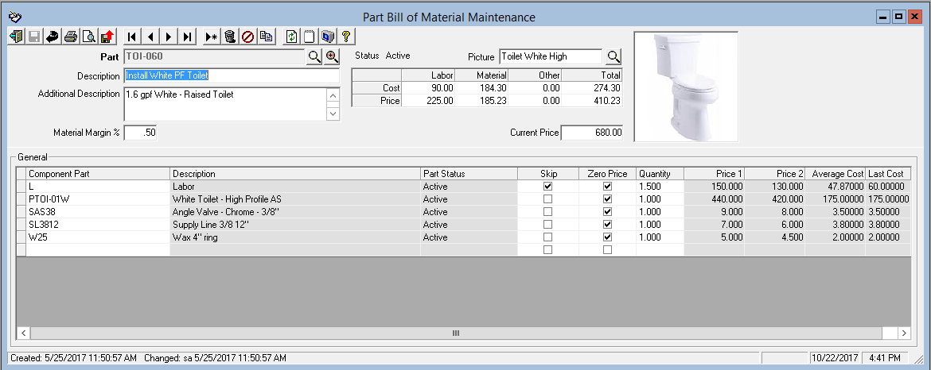
Ascente – Flat Rate Processing
Creating a Part Bill of Material Record
FlateRate/ Maintenance / Part Bill of Material program
This is the Part record for this Bill of Material record.
This is the assigned Price-1 for the part TOI-060
The ‘Slip’ flag will prevent this part from being added when this task TOI-060 is entered in a order entry program.
IMPORTANT: There is no direct relation between the prices for the component parts and this parent part price of $680.
These are Inventory – Part records for these component parts.
The ‘Zero Price’ flag should always be checked if the price for this task is determined by the price for the task TI-060 $680.00 as opposed to adding all of the detail component parts prices.

Slide 13
Ascente – Flat Rate Processing
Flat Rate Price Books
Ascente allows you to maintain your Bill of Material / Flat Rate Tasks and print your own price books.
Without the Ascente Flat Rate module, if you work with a vendors provided database or price books, you are now dependent on them for:
Providing new price books
Are the part numbers used yours or theirs? Can you work with their part numbers?
Are their parts numbers being used for inventory quantity tracking?
Updating costs and sell prices. Are the costs and sell prices yours or a derived national average?
Their availability to work on these is dependent on them, not your need.
There are costs involved for all of these.

Slide 14
Ascente – Flat Rate Processing
Flat Rate Price Books
These are used by the technicians to determine pricing and as a sales tool to present to customers.
Ascente can print these based on the existing Part Bill of Material records.
Many accounts have these customized for their company and their specific requirements.
Factors to consider are:
Presentation
Ease of use for the technicians
Sorting
Pictures
Multiple Pricing Options
Primary and Addon tasks.

Slide 15
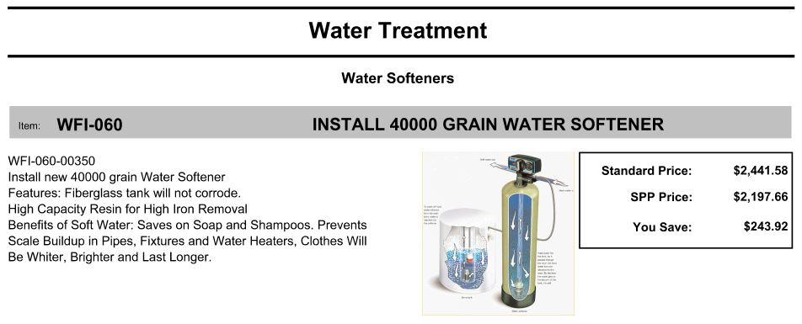
Ascente – Flat Rate Processing
Flat Rate Price Books
Example #1:

Slide 16
Ascente – Flat Rate Processing
Flat Rate Price Books
Example #2:

Slide 17
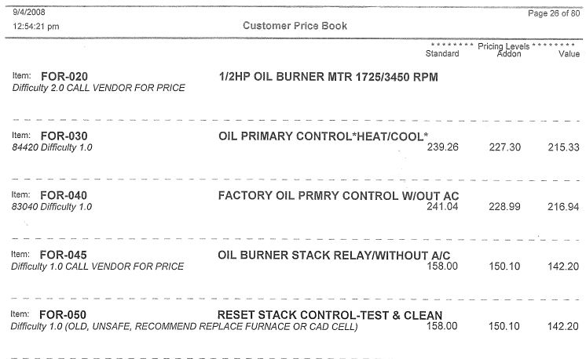
Ascente – Flat Rate Processing
Flat Rate Price Books
Example #3:

Slide 18
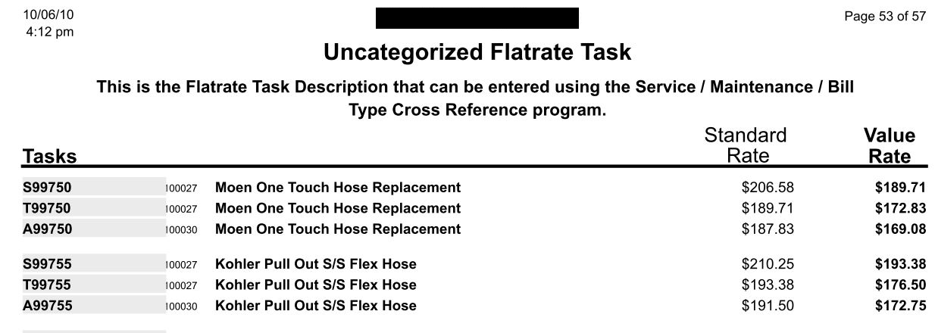
Ascente – Flat Rate Processing
Flat Rate Price Books
Example #4:

Slide 19
Ascente – Flat Rate Processing
Predetermined Pricing
Ascente has the ability for you to assign up to four different prices for each flat rate task. You determine which price is used based on the Price Level Code assigned to the service order.
Your flat rate price books can include any or all of these prices.
You can of course override any of the default prices.
We always recommend that pricing is determined by the task part and not the tasks component parts.

Slide 20
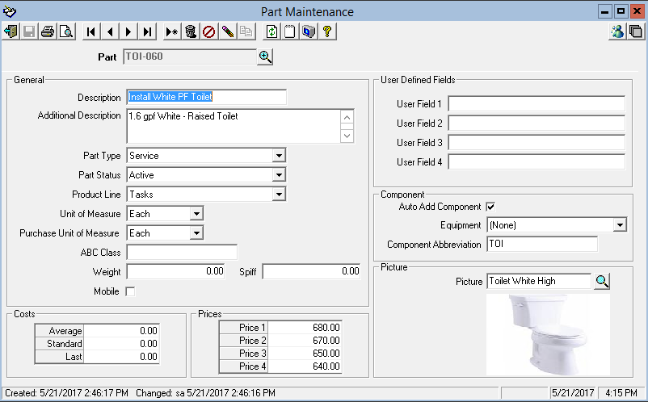
Ascente – Flat Rate Processing
Multiple Pricing Levels
Every service order will reference a ‘Price Level’ that will determine whether price 1, 2,3 or 4 is used.
We always recommend that ‘Price 1’ be your standard or base price and all discounted prices be in prices 2-4.

Slide 21
Ascente – Flat Rate Processing
Pricing
Part Bill of Material Level Pricing
This is when a price is associated with the Part Bill of Material or Flat Rate part as opposed to the component parts. When a component part is added or deleted, the price does not change.
Component Part Level Pricing
This is where the price for the Part Bill of Material is NOT determined by the price associated with the Part Bill of Material but by the sum of all of the component parts. When a component part is added or deleted, the price does change.

Slide 22
Ascente – Flat Rate Processing
Ease of Data Entry
One of the primary advantages is that you can enter one Part Bill of Material – Part and then have all of the associated parts be automatically entered.
You could accomplish the same data entry results by just manually entering in all of the parts individually, but why do that for common tasks when you can create a Part Bill of Material record and accomplish the same thing.
These can be used when entering:
Work Orders
Purchase Orders
Inventory to Job Transfers

Slide 23
Ascente – Flat Rate Processing
Flat Rate Task Analysis Reports
The Flat Rate Task Analysis option allows you to print the Flat Rate Analysis Report or the Flat Rate Detail Report.
Flat Rate Analysis
This report can be used to determine the following information:
Average Sell Price for the Task (Are techs charging more or less than the Flat Rate Price Book amounts?)
Parts Used vs Budgeted Quantities (Are techs using all of the parts that they should? Are techs using additional parts that need to be added to the task?)
Labor Time Used vs Budgeted Labor Time (Is the Task Labor Time too high or low? Are just certain techs taking longer, and thus need more training?)
Number of times the task was sold (Should the Task be removed from the system since it is rarely sold?)

Slide 24
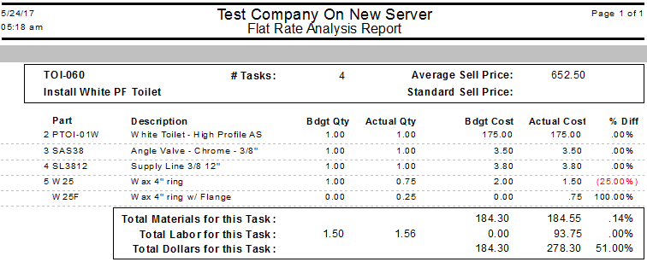
Ascente – Flat Rate Processing
Flat Rate Task Analysis Report
Flat Rate Analysis

Slide 25
Ascente – Flat Rate Processing
Flat Rate Task Analysis Reports
Flat Rate Detail
This report prints a list of the invoices where the tasks were sold, by whom and for what price.

Slide 26
Ascente – Flat Rate Processing
Recommendations
Your flat rate tasks will need to be reviewed and updated at least annually for :
Labor & material cost, sell price and quantity changes.
New or replacement parts.
New tasks that need to be created
Existing tasks that need to be edited or deleted
These price books need to be printed and distributed to the technicians with the updated changes.
Try and test this on a small scale and test before doing all of the flat rate tasks.
Know that you will never have a flat rate task for every possible service request you ever you get.
Start with your most common service requests.
Know that this is a continuing and evolving process.

Slide 27
Ascente – Flat Rate Processing
We thank you for attending this webinar and choosing Ascente.
Please let us know if you have any questions or world like a follow-up call to discuss this in more detail.
More training videos like this are available on our website. www.compusource.com
http://www.servicecontractorsoftware.com/

